Slide 1
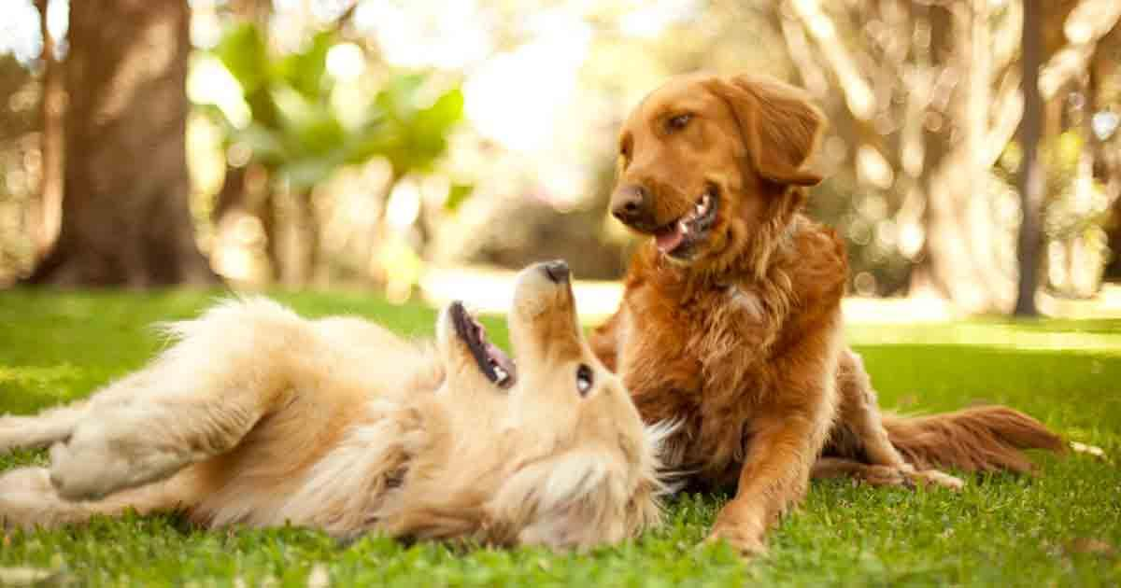
Dog Dating App
Ian Woods
Joshitha Mandali
David Acharya

Slide 2
AIM OF THE APP
Doggy-Date: A dating app for dogs.
More specifically, dog owners can search other dogs in their area and establish playdates.
Follows standard dating app model (Bumble, Tinder), but instead of connecting humans, it connects dogs.
Users can
“Like” other dogs for potential playdates
If two dogs “like” each other, a match is made, and users can chat to establish playdates.
Scope limitation: will focus only on the dogs, not the owners.

Slide 3
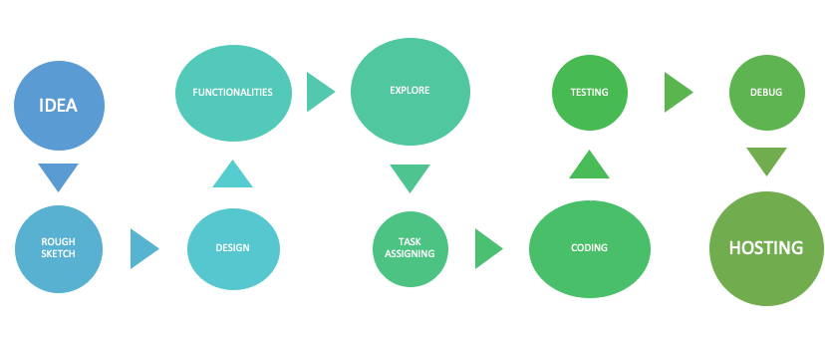
PROCESS FLOW

Slide 4
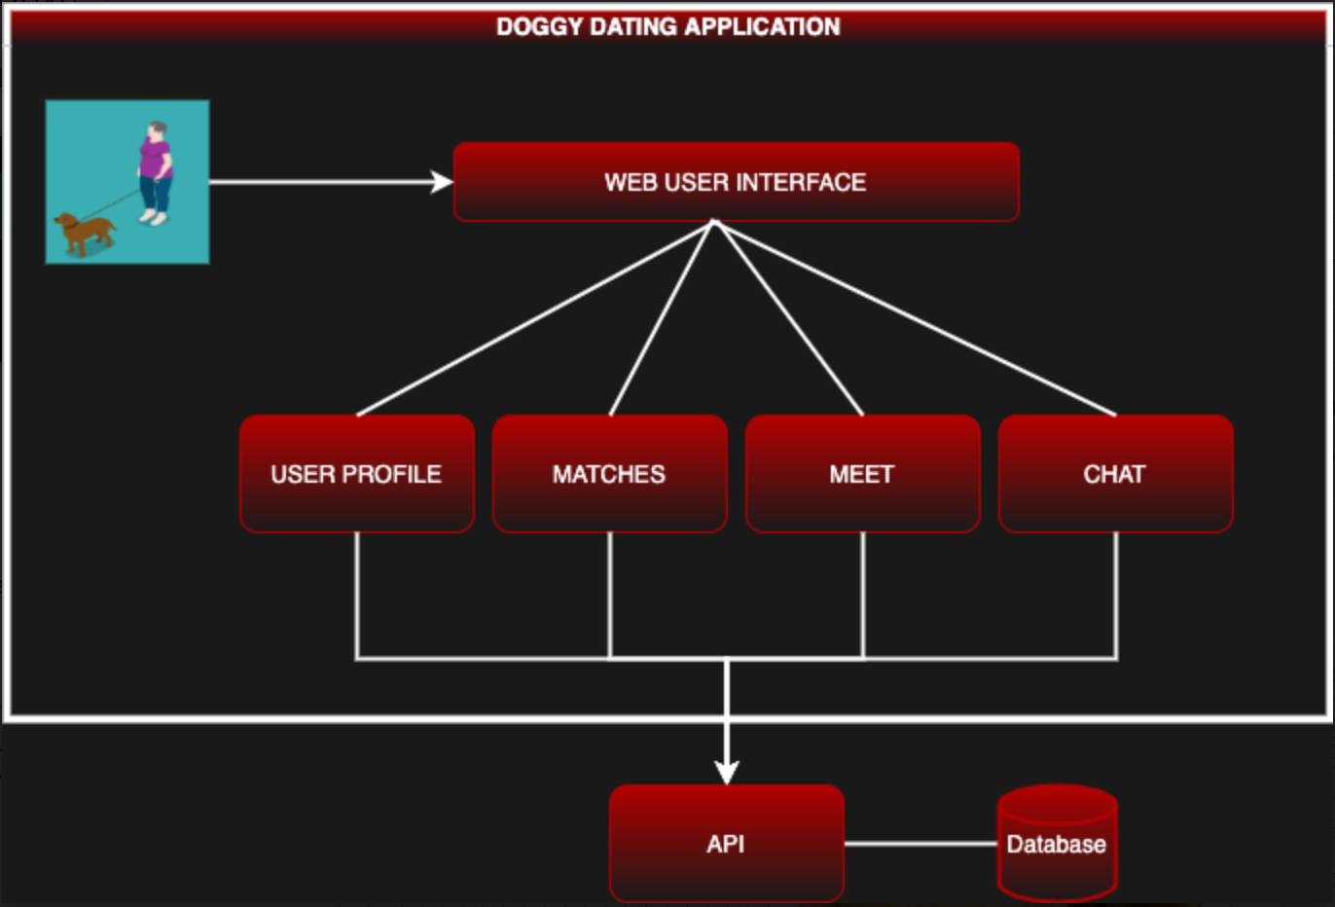
ARCHITECTURAL DIAGRAM

Slide 5
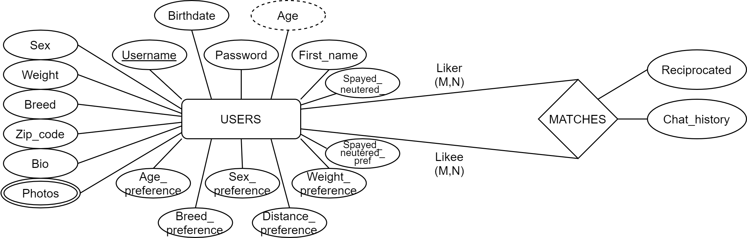
DATABASE ERD

Slide 6
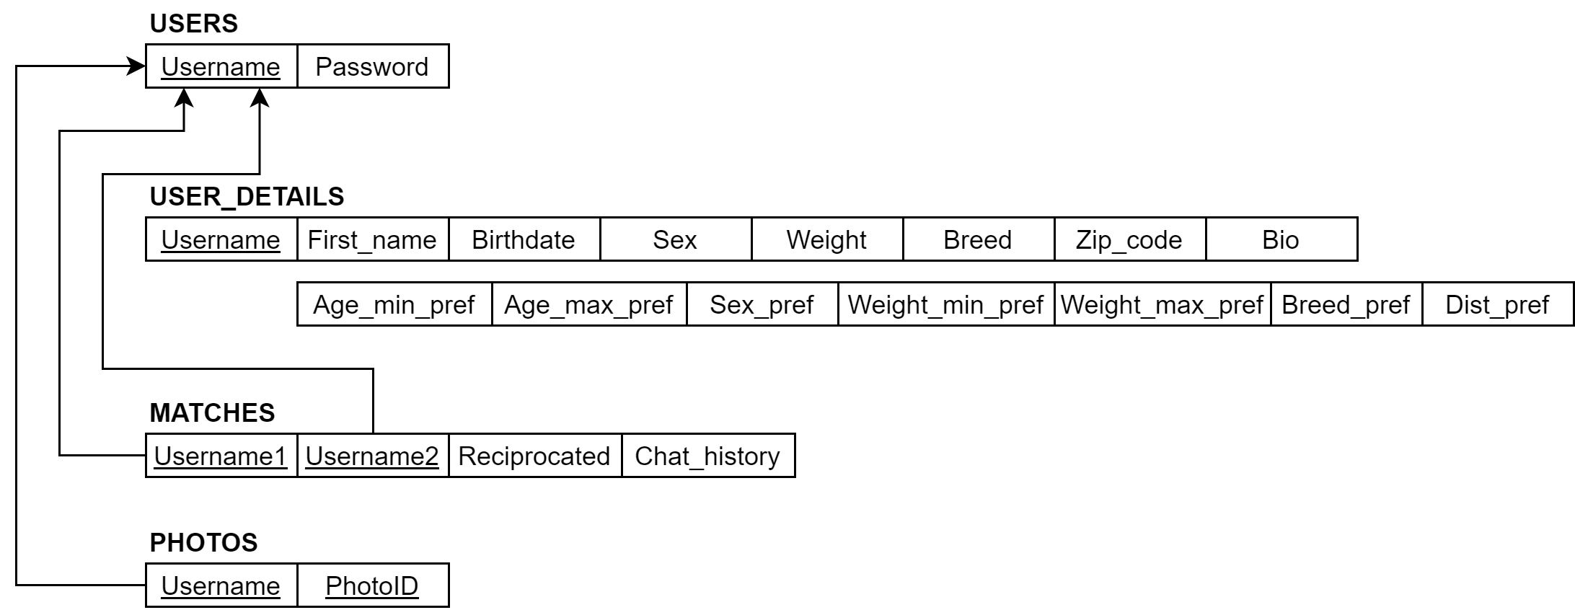
DATABASE ERD

Slide 7
TECHNOLOGIES
Programming JavaScript
Framework React, CSS, JSX
Database MySQL
Cloud Service Heroku, AWS

Slide 8
TECHNOLOGIES: KEY NODEJS MODULES
express : API framework.
mysql : Driver for integrating a MySQLl DB with a NodeJS server
express-session: Used to create user sessions upon login.
cookie-parser: Used to sign Session ID with secret string
socket.io: Real-time messaging tool used to build chat functionality.
express-fileupload: Used for uploading use photos.

Slide 9
Features/User Stories
User login and logout
Create a new User Profile/Signup
Editing the existing User Profile
Uploading User Photos for a profile
Creating a Match
Destroying a Match
Chatting

Slide 10


DEMO

Slide 11
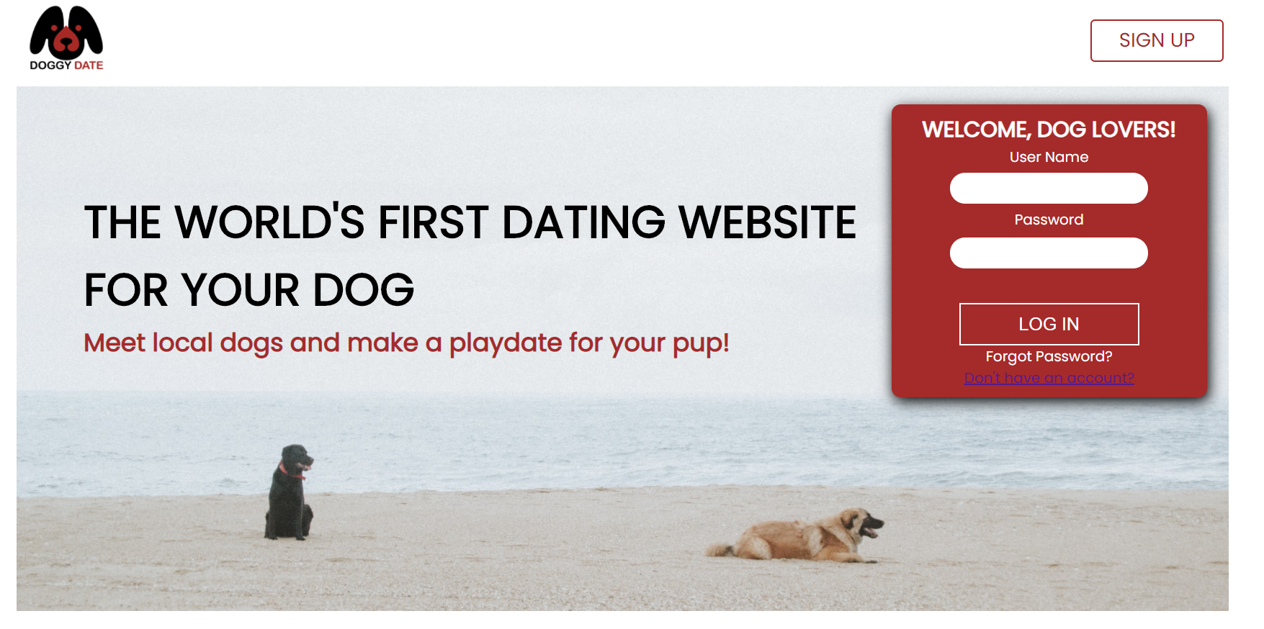
DEMO: USER LOGIN

Slide 12
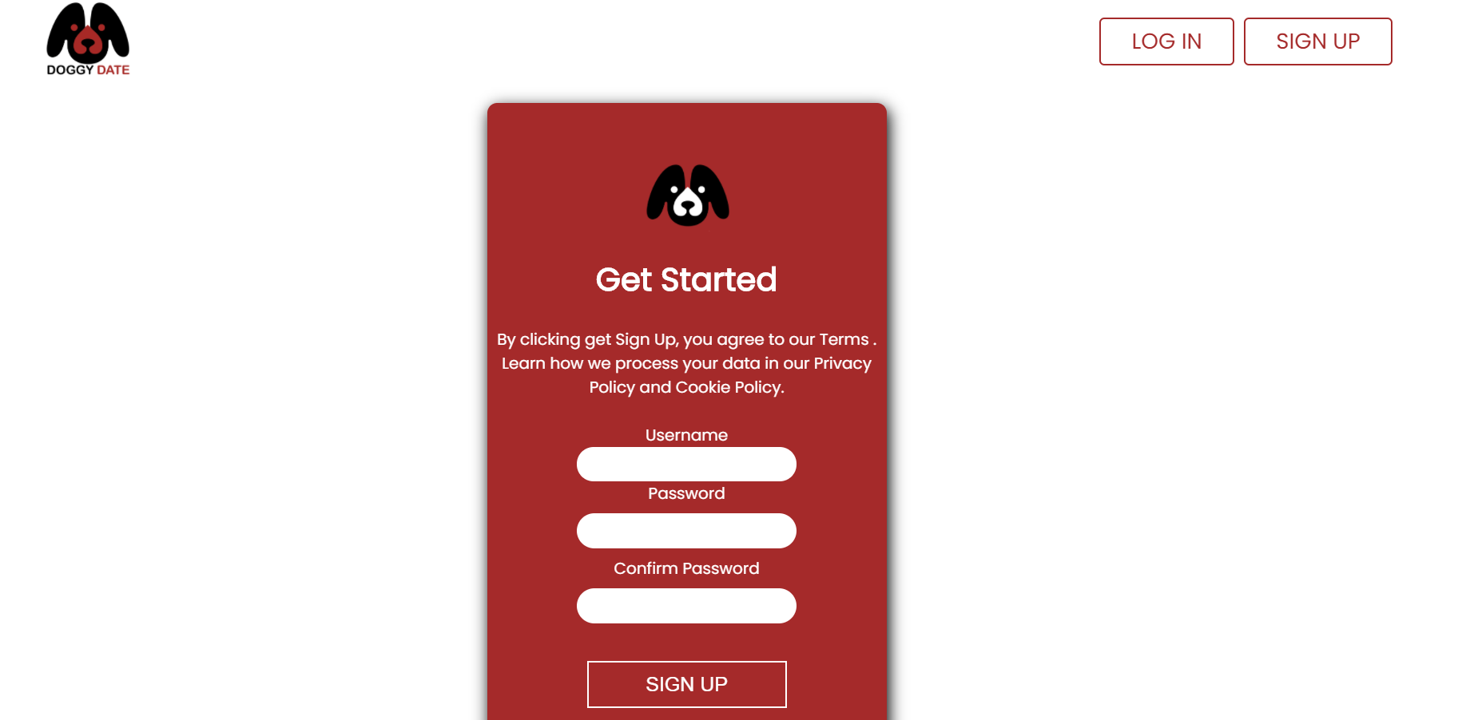
DEMO: USER SIGN UP

Slide 13
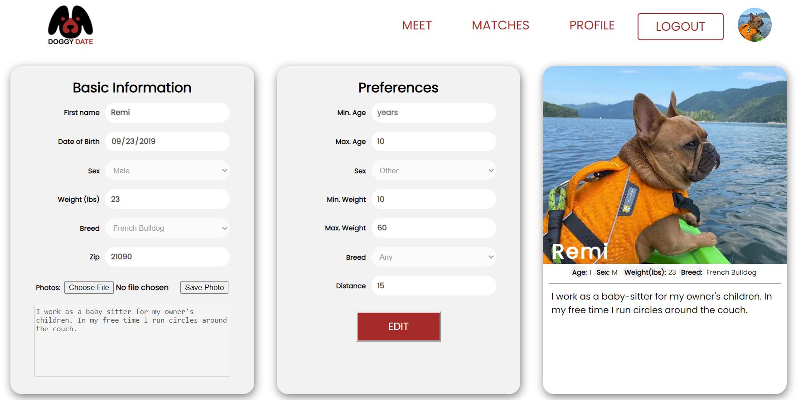
DEMO: EDIT USER PROFILE

Slide 14
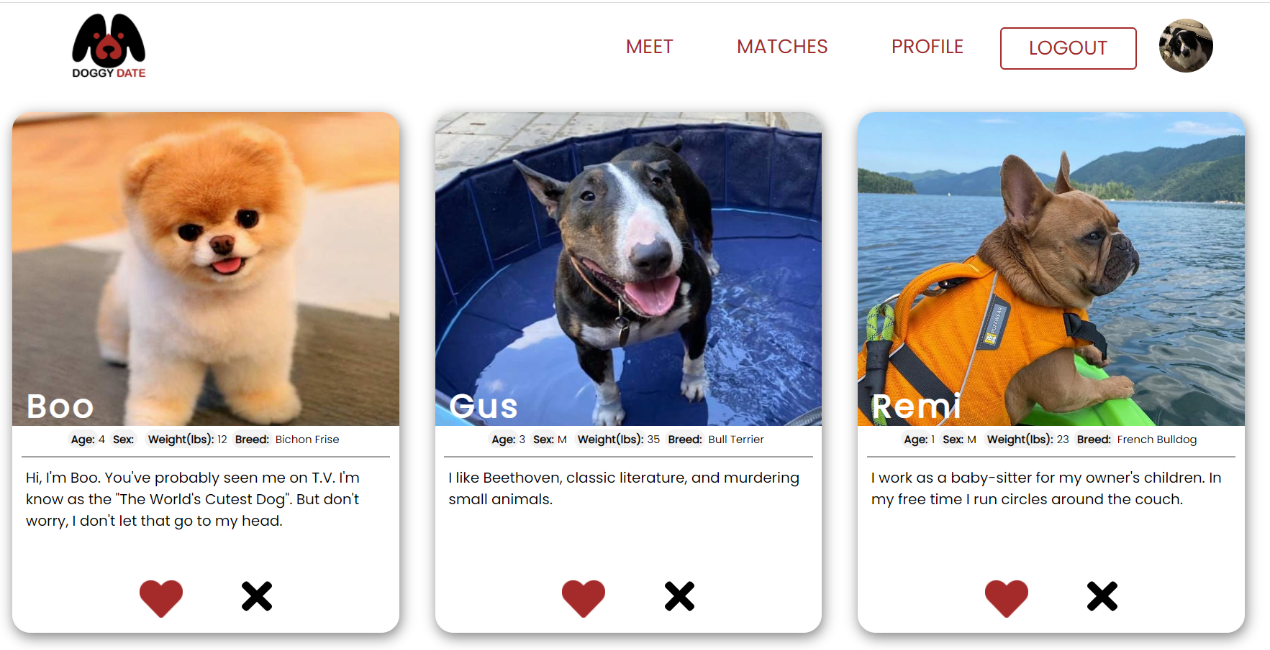
DEMO: MEET OTHER DOGS

Slide 15
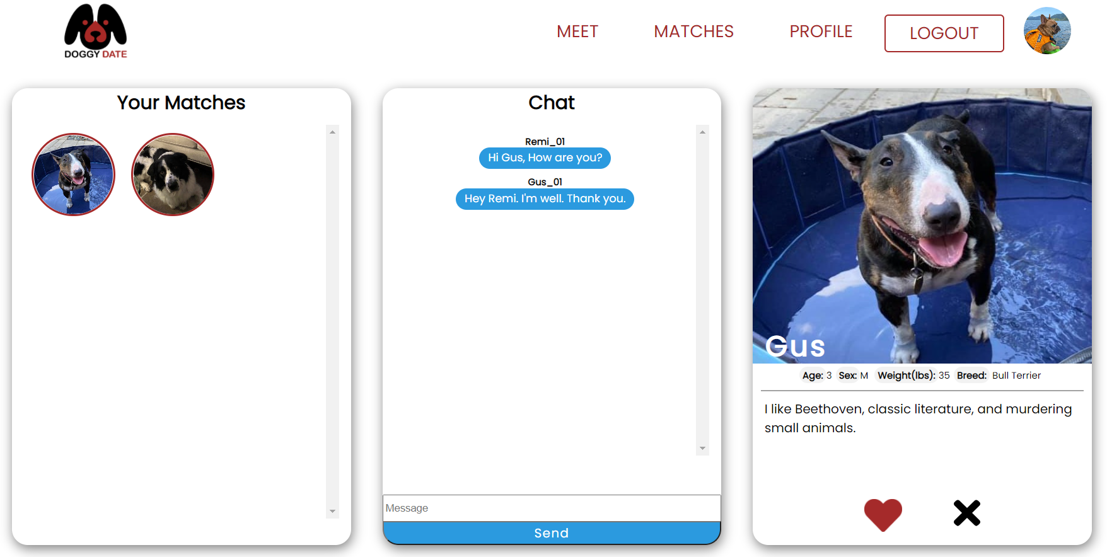
DEMO: CHAT WITH OTHER DOGS

Slide 16
TESTING
Functional Testing
Integration Testing
Unit Testing

Slide 17
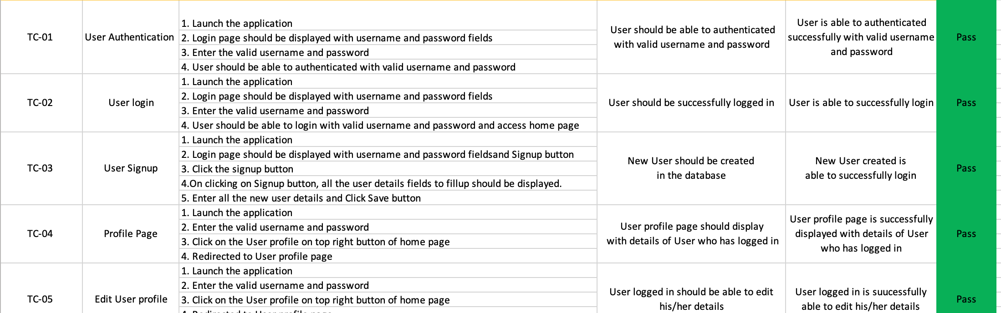
TESTCASES

Slide 18
CHALLENGES
Learning new technologies
Asynchronous programming
Time limit/restriction – Hosting
No expertise

Slide 19

LESSONS LEARNT

Slide 20
FUTURE WORK
Filter by preferences and location.
Save chat history in database.
Save session information in database.
Notify users of new matches and new messages.
Security.

Slide 21
Questions?
Thank you

